Slide 1

ZOMATO RESTAURANT ANALYSIS
BY Kishore b g
From newton school

Slide 2

INTODUCTION
“Where Taste meets Data, your Appetite for analytics Starts there.”
Welcome to Zomato Restaurant Analysis
Here, various sets of insights and visualizations are available that would be helpful for us to analyse and decide whether to open a new restaurant in a particular city or country with a large amount of profit.

Slide 3
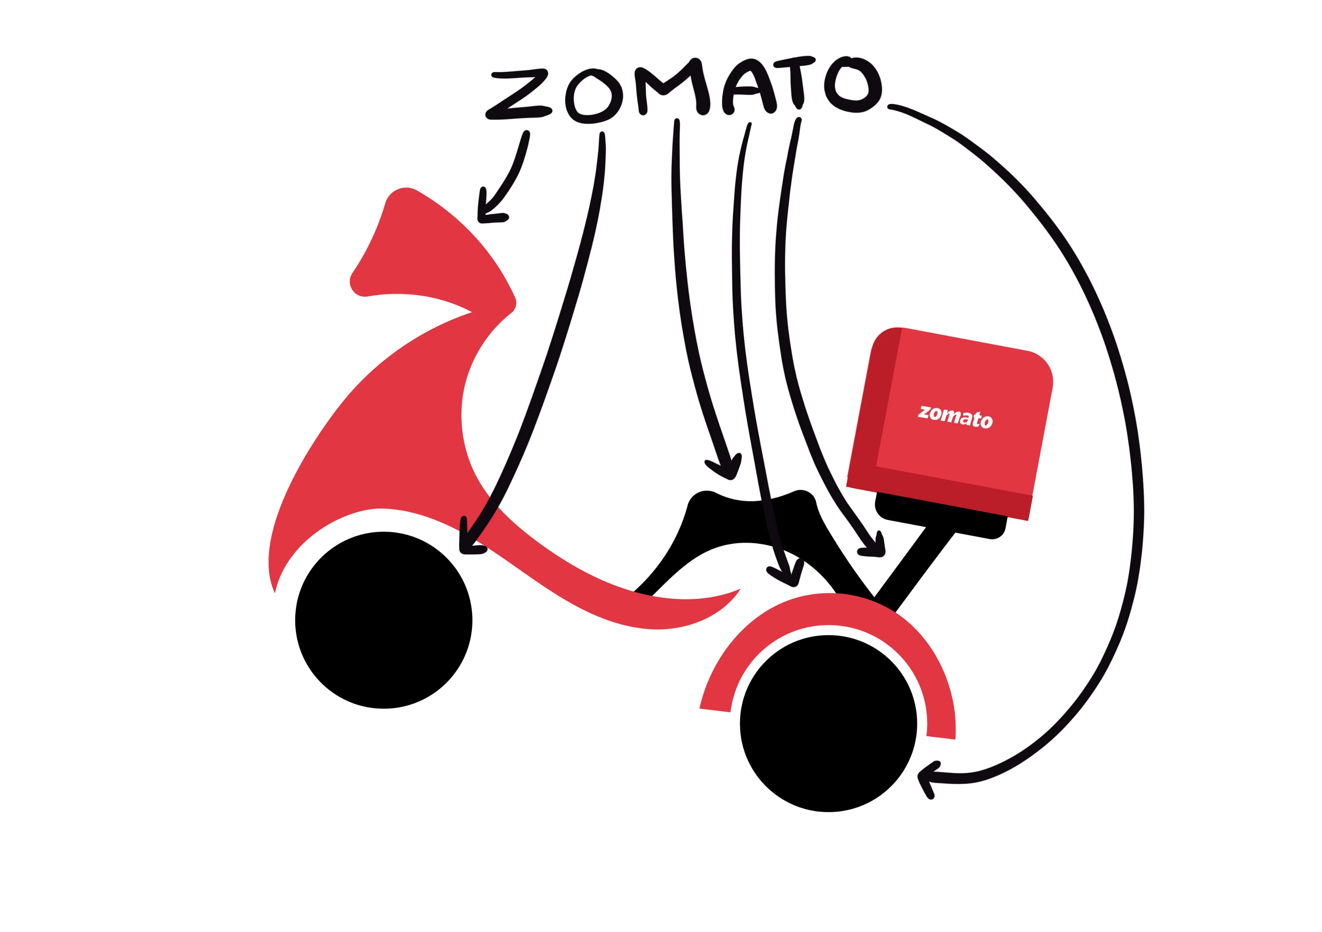
AGENDA
Introduction.
Identified Problem Statement along with the Dataset.
Schema of the raw dataset.
Methodology.
Analysis of Insights using Charts.
The Zomato Dashboard.
Final Recommendations
Conclusion.

Slide 4
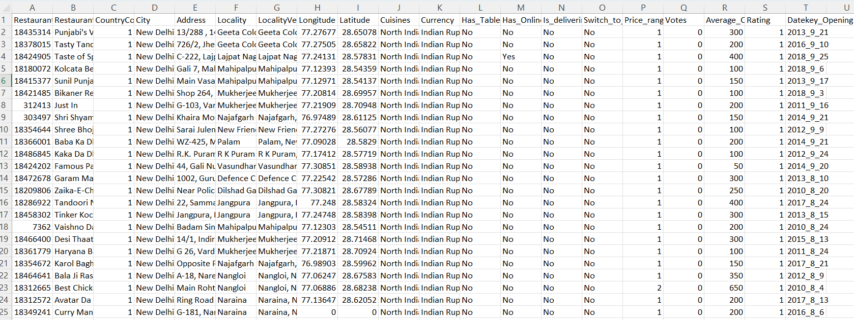
Identified Problem Statement
You are hired as a consultant data analyst by Zomato, where the team is looking for expansion and opening restaurants. Your task is to come up with strategies/suggestions about opening newer restaurants.
Here is the Link for the whole dataset
Along with the created Dashboard (in upcoming slides) Link

Slide 5
DATA OVERVIEW (Schema of Raw Data)
Restaurant ID: Unique identifier for each restaurant.
Restaurant Name: The name of the restaurant.
CountryCode: Country code of the location where the restaurant is situated.
City: The city where the restaurant is located.
Address: The specific address of the restaurant.
Locality: The locality or neighborhood where the restaurant is situated.
Locality Verbose: Detailed information about the locality.
Longitude: The geographical longitude coordinate of the restaurant.
Latitude: The geographical latitude coordinate of the restaurant.
Cuisines: The type of cuisine offered by the restaurant.
Currency: The currency used for transactions in the restaurant.
Has_Table_booking: Indicates whether the restaurant has a table booking option (Yes/No).
Has_Online_delivery: Indicates whether the restaurant offers online delivery (Yes/No).
Is_delivering_now: Indicates whether the restaurant is currently delivering (Yes/No).
Switch_to_order_menu: Indicates whether users can switch to the order menu (Yes/No).
Price_range: A numeric value indicating the price range category of the restaurant.
Votes: The number of votes or ratings/(feedback) received by the restaurant.
Average_Cost_for_two: The average cost for two people dining at the restaurant.
Rating: The overall rating of the restaurant is based on user reviews.
Datekey_opening: The date when the restaurant was opened.

Slide 6

Methodology
First of all, we must get to know the basic information about the identified problem, and we must create a few basic insights.
Secondly, we must clean the raw dataset by checking for inappropriate data, missing values, and duplicate rows.
Then we must use the text-to-column function if the data is combined within a single column.
The main part is creating various insights with the help of the obtained Dataset, which must help us to obtain the goal.
Next, our main motive is to create a Dashboard for the obtained dataset with the usage of various combinations of pivot tables and charts, which must prove all the insights are correct and required changes in insights according to the results in the Dashboard.

Slide 7
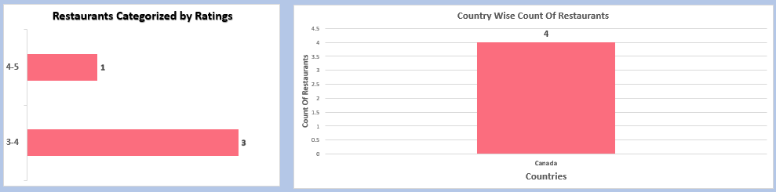
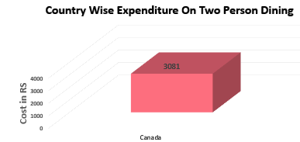
Analysis of Insights using Charts (Insight regarding restaurant rating and cost of dining of two person)
In Canada, opening a restaurant in cities like Vineland Station and Chatham Kent will be best to execute a low-priced restaurant, and opening a restaurant in other cities will also be profitable since Canada has the lowest number of restaurants. (The below chart represents Canada)
These are the charts we must always focus on because they provide answers for all the factors required to open a restaurant, such as the number of. restaurants, price range, and rating.
Similarly, the other countries and cities I would like to suggest are,
Philippines- Restaurants can be opened in all cities, because each city has only 1 or 2 restaurants with a single price range, thus opening at any moderate price range will be profitable.

Slide 8
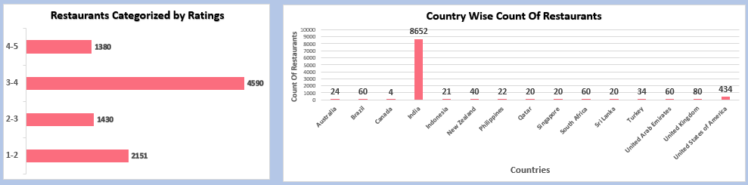
Analysis of Insights using Charts (Insight regarding restaurant rating and cost of dining of two person)
Qatar- Doha is the only city where all the restaurants are located according to the provided data, and opening a restaurant in the price range of 2000-5000 will be the best decision.
Singapore – opening a restaurant at any price range will be profitable because only 1 or 2 restaurants are available at each price range, and opening at low to moderate prices will also profit online food delivery companies.
Indonesia- Bandung, Borger, Tangerang has only 1 or 2 restaurants, so opening a restaurant in these cities is a better idea.

Slide 9
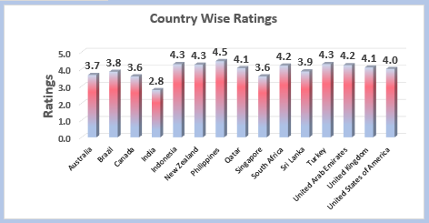
Insights regarding ratings for restaurants that are opened in suggested countries.
I would like to use the visualization concept of Country wise Ratings,
Here, the above column chart represents the country-wise ratings of available restaurants,
In Singapore, only 3 restaurants have a rating above 4, thus, our main motive is to open a restaurant that can serve well, such that the rating provided by customers will be above 4.

Slide 10

Insights regarding ratings for restaurants that are opened in suggested countries.
In Indonesia, Ratings are good for the majority of the restaurants, and cities like Bandung, Bogor, and Tangerang have only one restaurant at each particular set of ratings.
In Qatar, Half of the available restaurants have a rating of 4 and above. Thus, only half of the total restaurants have a rating of 4 and above, so we must aim to run a restaurant with a rating of 4 and above.
In the Philippines, all the restaurants have ratings of above 4, and it will be a Competition for us to run restaurants there. But the good part is that only 1 or 2 restaurants are available in each city. Opening a restaurant in Santa Rosa will be an added advantage.
In Canada, only 1 restaurant has a rating of above 4. Thus, we must aim to open a restaurant that meets the desired requirements of customers and acquire a rating of above 4.

Slide 11
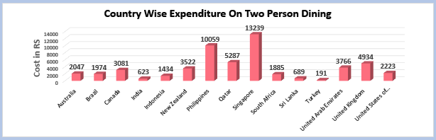
Insights regarding the current expenditure on food in the suggested countries
Country-wise Expenditure on
The two-person Dining Chart will be
The best approach to identify the current expenditure on food in my suggested countries, because it provides the availability of restaurants in each particular set of price ranges
The countries like Qatar, Singapore, and the Philippines have fewer restaurants and are a little richer compared to other countries, opening a restaurant in those countries at any price range will be profitable.

Slide 12
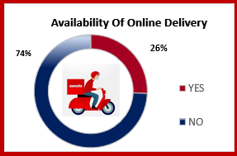
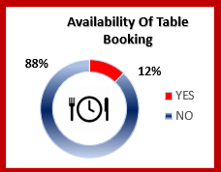
Insights for the continuity of Table Booking and Online food Delivery
At first I have used slicer operation for each country and found that Online delivery and table booking is available mostly in India only. We can also view average rating of restaurants that offer both by below formula,
=AVERAGEIFS('Raw Data'!W2:W9552,'Raw Data'!O2:O9552
,"Yes",'Raw Data'!N2:N9552,"Yes") By execution we get =3.6
We can also view the average rating of restaurants that don’t offer
both by below formula,
=AVERAGEIFS('Raw Data'!W2:W9552,'Raw Data'!O2:O9552,
"No",'Raw Data'!N2:N9552,"No") By execution we get =2.68
I would like to conclude that customer ratings increase with the availability of online delivery and table booking. Thus, I suggest that we should increase online delivery and table bookings.

Slide 13
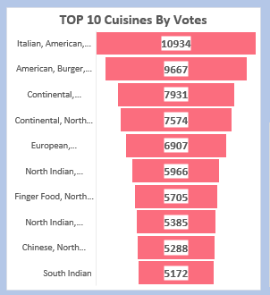
Insights for the top 10 Cuisines Preferred by people around the world
Top 10 Cuisines By Votes
This chart provides the cuisines that are mostly preferred by people all over the world.
When we use a country-wise slicer operation, we can view the cuisines that are particularly preferred by the people of the selected location.
Also, the choice of cuisine differs from location to location, where people of different cultures prefer different types of food. Thus, we have to analyse the food preferred by people at each particular location when we have to open a new restaurant.

Slide 14
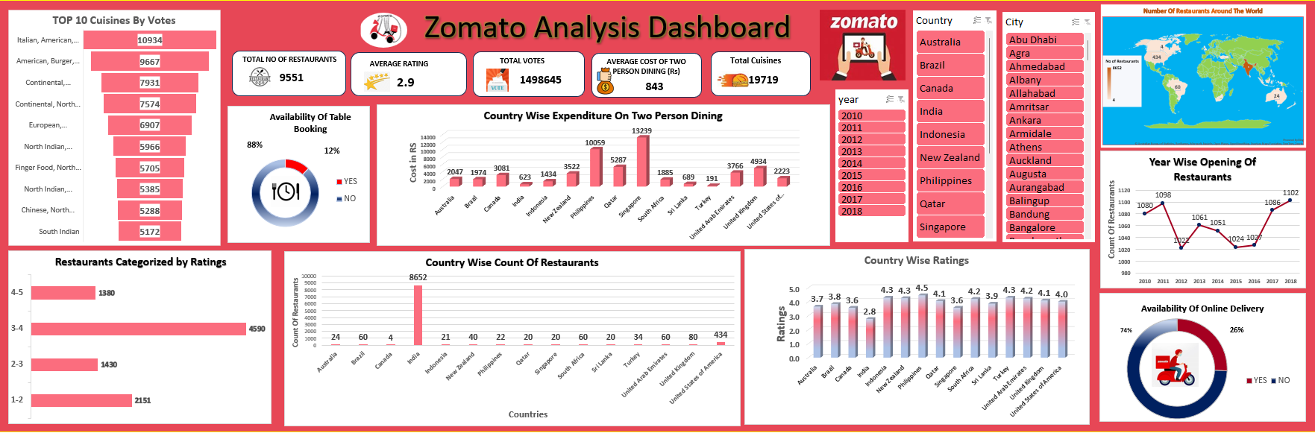
The Zomato Dashboard

Slide 15

FINAL RECOMMENDATIONS (Analyzation of Insights)
List of a few countries where the team can open new restaurants with less competition.
By using the slicer in the dashboard, I have analysed and I would like to suggest that opening a new restaurant may include three main factors: number. of. availability of Restaurants, price Range of those Restaurants, and rating of those Restaurants.
All three factors can be visualized through my Zomato Dashboard, and I have found that opening new restaurants in countries like Canada, the Philippines, Qatar, Singapore, and Indonesia would be the best idea and would be profitable projects.
Countries like Qatar, Singapore, and the Philippines have fewer restaurants and are a little richer compared to other countries; opening a restaurant in those countries at any price range will be profitable. In Canada, opening a restaurant is essential because it is a country with the least number of restaurants. Indonesia has less number of restaurants with a low price range.
In my view, just opening the highest range restaurant won’t be much profitable for online delivery companies. Thus, these are the countries where we can open a restaurant at a low to moderate price range and gain more profit.

Slide 16

Conclusion
Thus, the fact is that online food delivery options are higher in count at low-mid range restaurants than compared to very high range restaurants; we must increase the availability of low-mid range restaurants.
After visualizing through my Zomato Dashboard, I found that opening restaurants in countries like Canada, the Philippines, Qatar, Singapore, and Indonesia would be the best idea and would be profitable projects.
I have also highlighted the rows with conditional formatting of two colours, one representing immediate need and the other with a lesser number of competitors in the sheet named “raw data”.

Slide 17



